Slide 1
Automatic Door Opening System During Pandemic
Presented By:
A-12-Chinmay Gaikwad
A-72-Pratik Zeeman

Slide 2
Introduction
In modern days, many intelligent technologies are introduced in our environment.
An Automatic Door Opening System is a project which automatically opens and closes the door by detecting a person or object.
You might have seen Automatic Door Opener Systems at shopping malls, cinemas, hospitals etc. where, as soon as a person approaches the door (at about 2 or 3 feet), the door automatically slides open. And after some time (about 5 to 10 seconds), the door closes by sliding in the reverse direction.
The design and implementation of system is done by Arduino hardware and the program is written in Arduino IDE and is simulated in Tinkercad software .

Slide 3
Problem Statement
Currently we are going through a COVID-19 pandemic globally.
The Virus is continuously spreading and indirectly affecting the health of humans.
Thus, to prevent us from the Virus we have designed a system which will helps us to take the necessary precautions to continue our daily work .
This pandemic is a major problem, so there should be some preventions made to save humans.

Slide 4
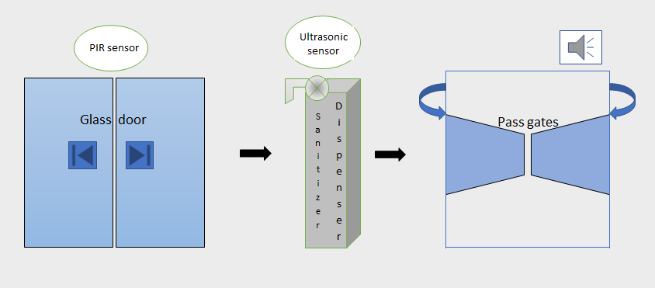
System Diagram

Slide 5
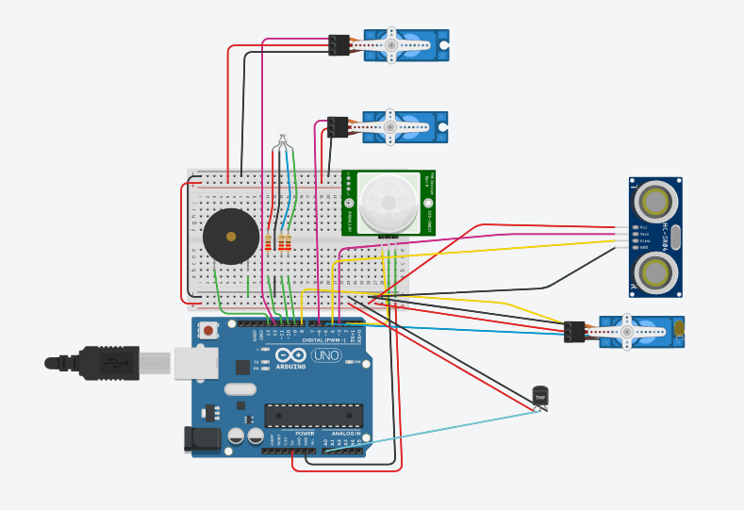
Circuit Diagram

Slide 6
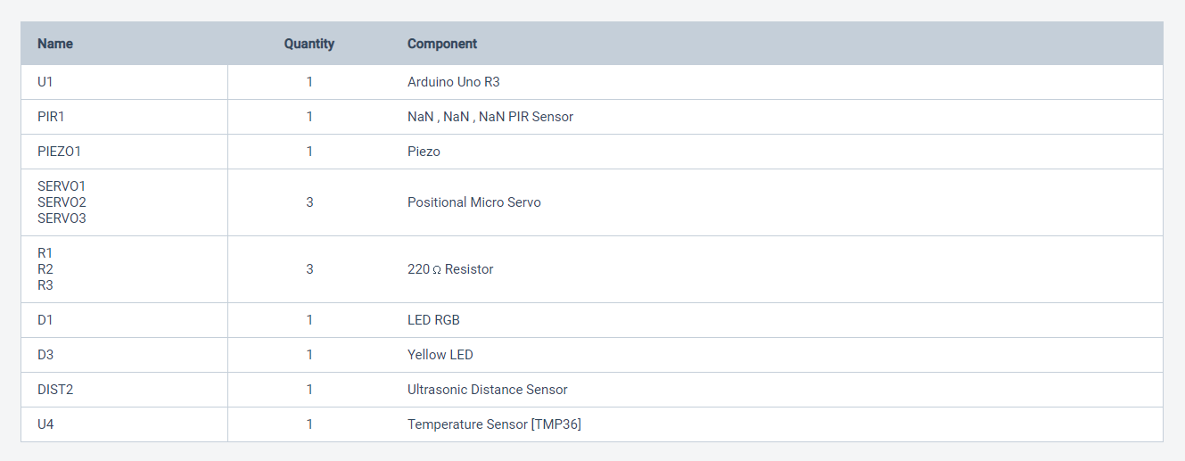
Components List

Slide 7
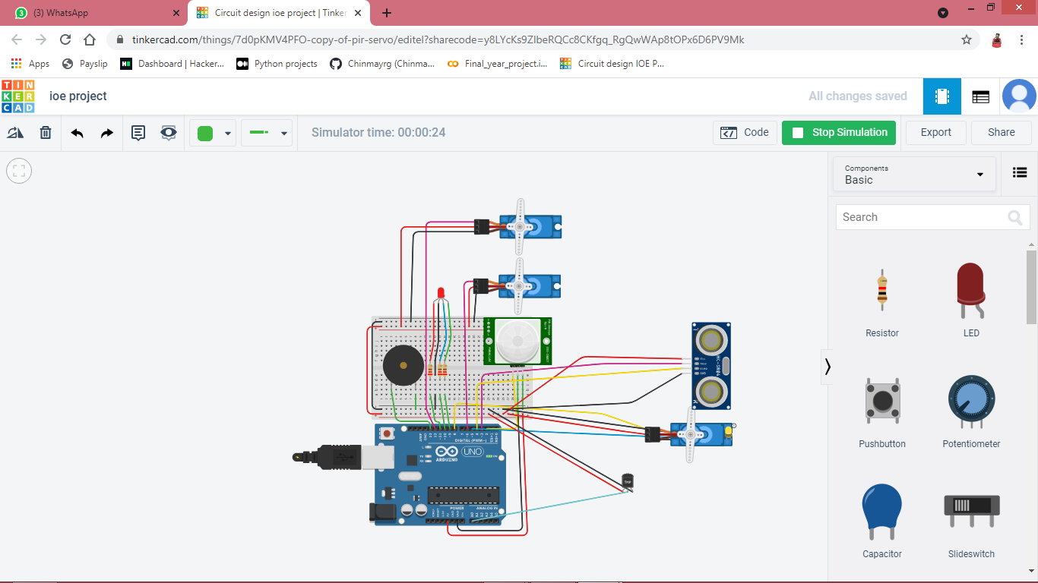
Results

Slide 8
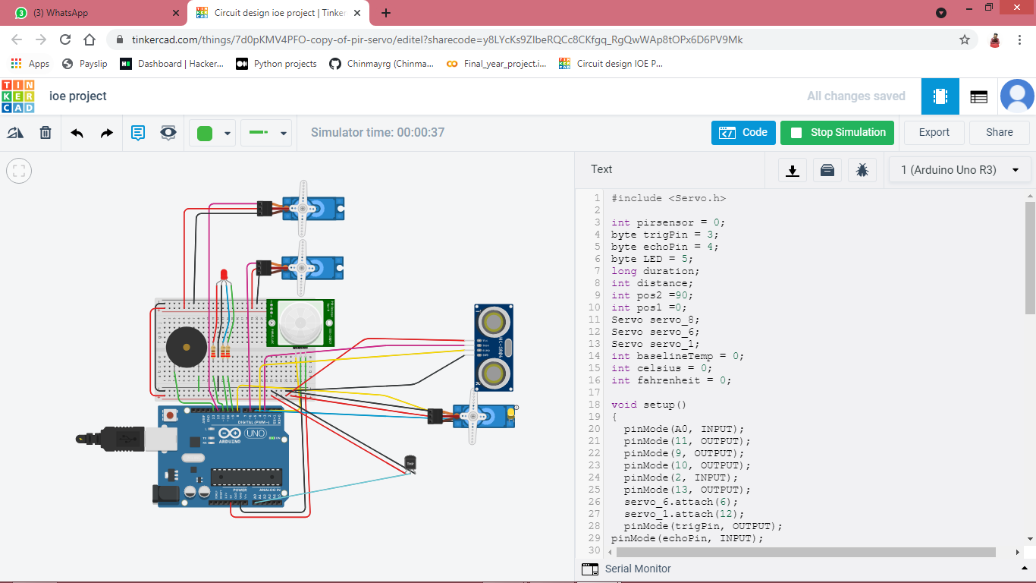

Slide 9
Advantages
It manages automatic opening as well as closing of Door and Sanitizer Dispenser opening.
Helps us take precautions from the Virus.
Less amount of air is transferred through the doors which indirectly maintain our sanity.
Applications
It can be used in Offices, Commercial Buildings, Shopping Malls, Hotels, Restaurants, etc.
It can be used as a primary step from prevention against the Virus.

Slide 10
Thank You

